Slide 1

Anomaly Event Detection In Videos Using Convolutional Autoencoders
Guided By:
SINI ANNA ALEX
Team Members:
1MS17CS071 - Nandish Mahadev Karki
1MS17CS091 - Rakshita N Patil
1MS17CS117 - Somandra Singh Rathore
1MS17CS138 - Yash Singh Chouhan

Slide 2
AGENDA
Introduction of Abnormal event detection in videos
Problem Definition: Current methodology, Proposed Methodology
Requirements of the system
Survey of papers on abnormal event detection
System Design

Slide 3
INTRODUCTION
Crowd analysis and scene understanding has broad range of applications in video surveillance.
One such application is detection of rare , interesting occurences of unusual object or suspicious behaviour.
Using convolutional autoencoders method does not require any additional human effort and can be easily applied to different scenes.

Slide 4
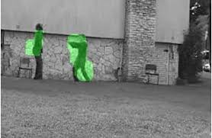
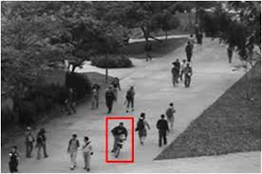
PROBLEM DEFINITION
The software is built to detect the abnormal events using convolutional autoencoders and to automate the quality of visual surveillance and enhance the safety of general public.
Abnormal event detection and localization in surveillance videos.

Slide 5
CURRENT METHODOLOGY
There are different approaches for detection of the abnormal events .
Classification methodology is one such approach but has some drawbacks in feature extraction strategies.
Dynamic Sparse Coding Approach uses sparse set of patterns which trained from normal videos and use sparse coding error as a measure to detect abnormal events.

Slide 6
Some other approaches are trajectory based approaches, hybrid model approaches, weakly-supervised learning approaches, novel online adaptive method.
The fewness of datasets that are suitable for training and absence of event localization are some limitations which current methodologies do not overcome.

Slide 7
PROPOSED METHODOLOGY
The proposed method uses convolutional autoencoders to learn features of video and detect the anomalies.
This approach consists of 3 stages: Pre-Processing Feature Learning Anomaly Detection
The main principle is that when abnormal event occurs , the most recent frames of video will be significantly different than the older frames.

Slide 8
Divide video into frames
Train Video Frames
Test Video Frames
Abnormal Events
Divide Trained Frames to Defined Patches
Divide Test Frames to Defined Patches
Used Train Model To Analyze Test Data
Background Estimation
Train Models
Normal Events
Feature Selection and Extraction
Object Detection

Slide 9
After the model is trained with more number of videos , the normal scene video is expected to have low reconstruction error while videos containing abnormal scenes are expected to have high reconstruction error.
By thresholding on the errors produced by each testing video inputs ,system will be able to detect the anomalies.
Improvement of accuracy is also taken care.

Slide 10
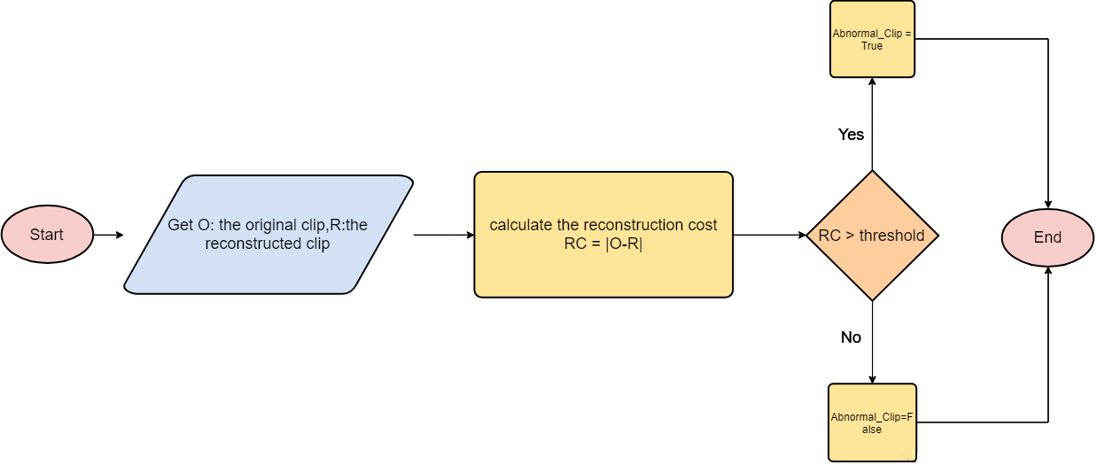
The test video frames are categorized into abnormal or normal frames using the reconstruction error.

Slide 11
SYSTEM REQUIREMENTS
SYSTEM REQUIREMENTS
The system should process the images in the chosen image formats and detect abnormality
It should display the exact time at which the abnormal event took place and user should be displayed the part of the video at which anomaly took place.

Slide 12
Option should be given to watch the video any number of times the user wishes.
If no anomalies detected, the user has to be notified that video is normal.

Slide 13
LITERATURE SURVEY
In paper “Abnormal Event Detection in Video using hybrid spatio-temporal encoder” , unsupervised dynamic sparse coding approach is used.
This method is based o online sparse constructability of query signals from an atomically learned event dictionary which forms a sparse coding base.

Slide 14
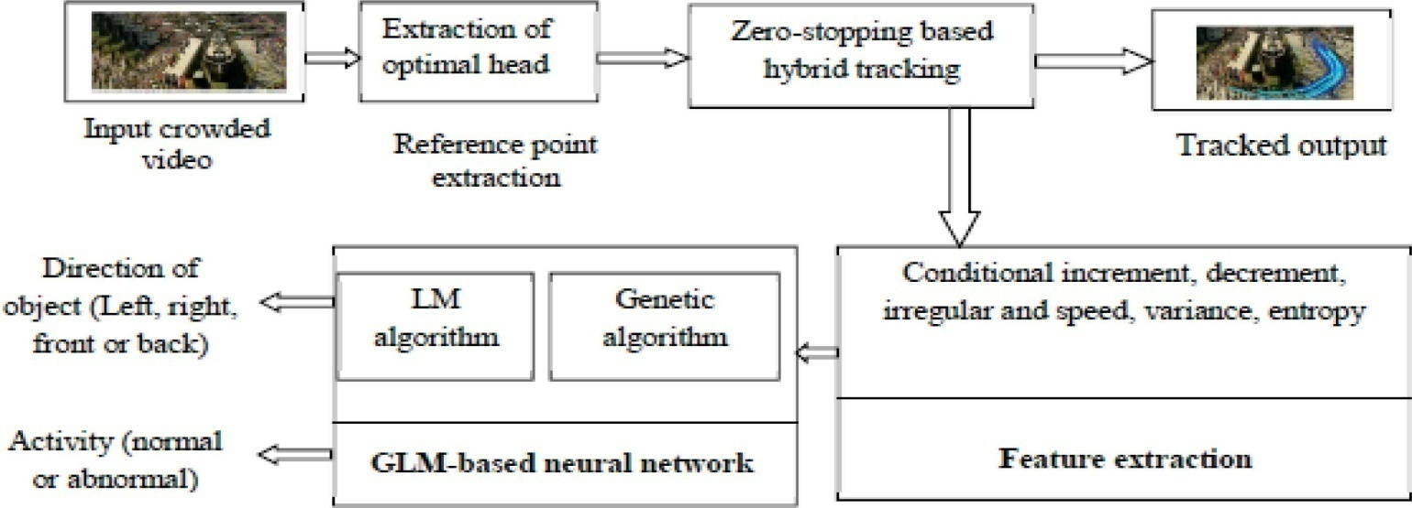
In paper “Unsupervised learning approach for abnormal event detection” uses two approaches: pure model and hybrid model.
Hybrid model alleviate the gradient vanishing problem and strengthen feature and encourage feature reuse in both spatial flow and temporal flow

Slide 15
There are several methods for abnormal event detection according to the applications .
Some of them are probabilistic methods or frame based classification methods. Some are rule based
Abnormal event detection in videos can be done using autoencoders ( Variational , Convolutional ), generative adversarial nets and Convo nets.

Slide 16
Some deep learning techniques such as Gaussian Mixture Model , Multiple instances Learning can be used.
Thus, at current most methods consists of some steps: Feature computation , transform of the aggregated features to certain domains, building of model and perform detection.

Slide 17
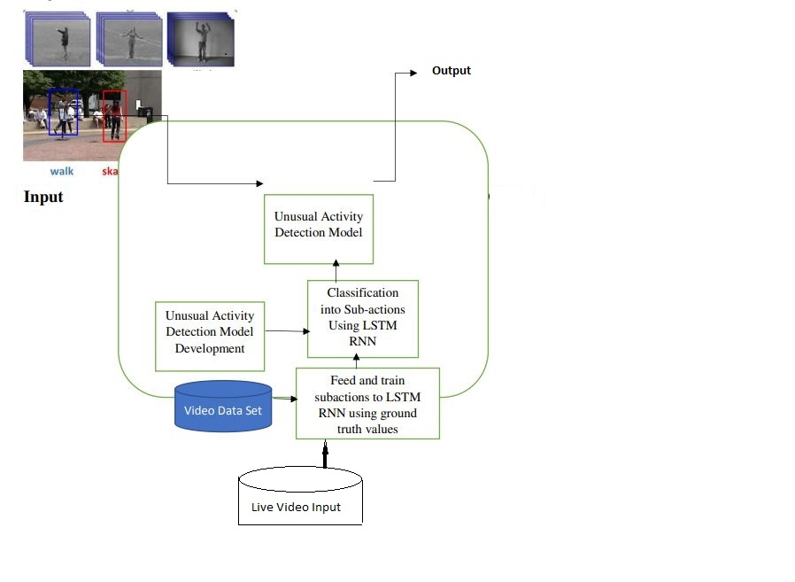
DESIGN
System Architecture

Slide 18
Overall Process
Gather input data set
Clean and Preprocess data
Feature Learning
Optimization of Model
Calculation of Regularity Score
Detection of Abnormal Event in test data

Slide 19
Work Flow
Input Video Data
Data Pre-processing
Features Learning
Training
Regularity Score
Testing
Test Video
Live Video Feed
Output: Abnormal/Normal

Slide 20
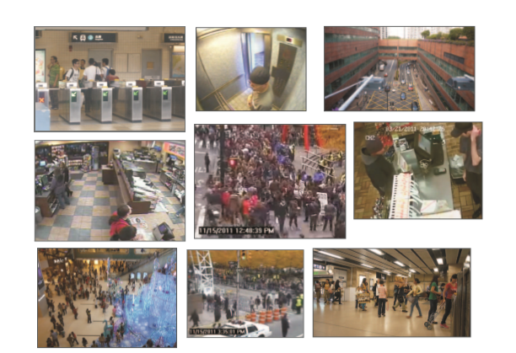
Data Pre-Processing
Input: Videos
Convert Videos into frames of size of (3,227,227)
img = PIL.Image.open(path)
img.resize((227,227))
img = numpy.asarray(img)
img.save(frame_path)
Video

Slide 21
Steps of processing video frames:
Resize the frames to 227*227
Rescale pixel values between 0 and 1
After that, the images are converted to grayscale to reduce dimensionality
Frames are then subtracted from its calculated global mean image for normalization to get unit variance.
Now the input is ready for training

Slide 22
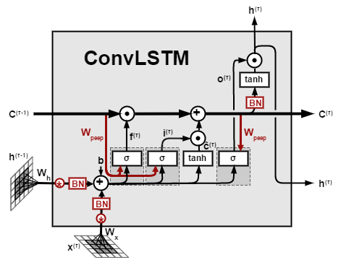
Feature Learning
We propose a convolutional spatiotemporal autoencoder to learn the regular patterns in the training videos.
Our proposed architecture consists of two parts|
spatial autoencoder for learning spatial structures of each video frame
temporal encoder-decoder for learning temporal patterns of the encoded spatial structures.
A ConvLSTM cell

Slide 23
Conv Long short term memory (LSTM)
Designed for sequence prediction problems with spatial inputs, like images or videos.
Output is influenced not just by the input but also by the history of inputs to the model
Features extracted are given as a input to the LSTM model for the output prediction.

Slide 24
Proposed Network Architecture

Slide 25
Training
def get_model(reload_model = True):
“””
Parameters
----------------
reload_model: bool
Load Saved model or retrain it
“””
if not reload_model:
return load_model(“path of pretrained model”)
get the training set created by preprocessing in form of Numpy array
training_set=np.load('training.npy’)
load the sequential model from Keras Library
seq = Sequential()
add Convolutional LSTM layers to the sequential model with the required input parameters via .add() method
compile the sequential model using activation function as sigmoid and loss as “mean square error” and optimizer as Adam
fit the training set into the sequential model of convLSTM filters
save the model to the defines path
return the seq model

Slide 26
Mathematically, convolution operation performs dot products between the filters and local regions of the input.
Suppose that we have some n x n square input layer which is followed by the convolutional layer. If we use an m x m filter W, the convolutional layer output will be of size (n-m+1)x(n-m+1).
A convolutional network learns the values of these filters on its own during the training process .

Slide 27
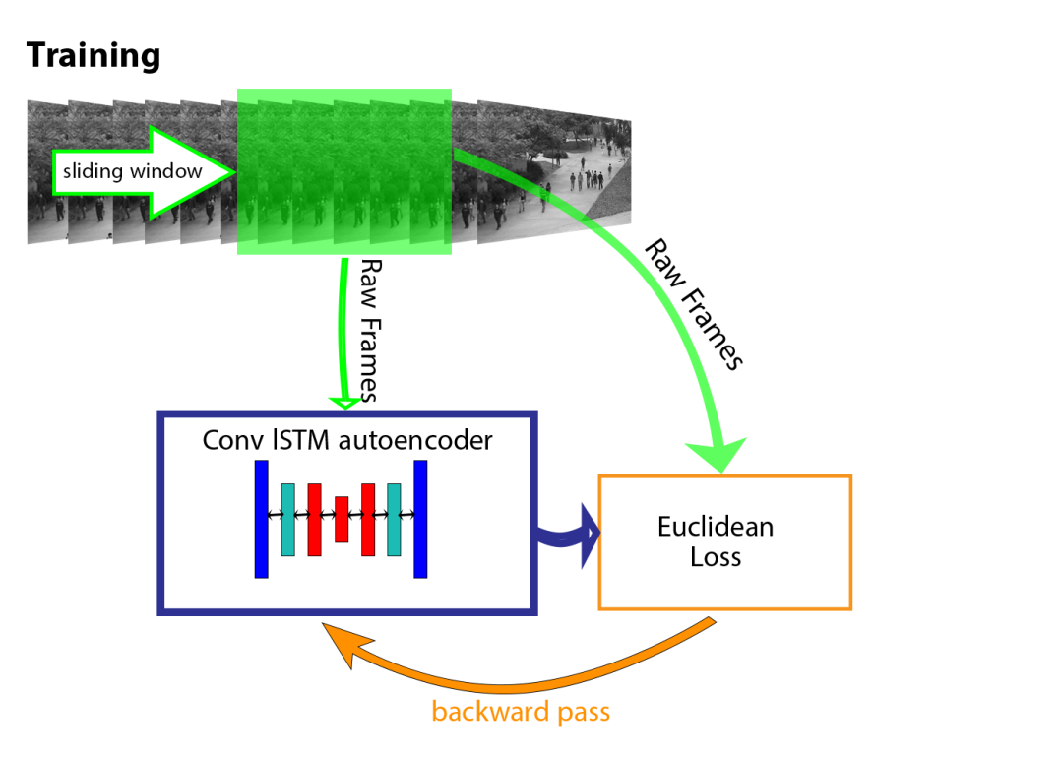
The spatial encoder takes one frame at a time as input, after which T = 10 frames have been processed, the encoded features of 10 frames are concatenated and fed into temporal encoder for motion encoding. The decoders mirror the encoders to reconstruct the video volume.

Slide 28

Testing
Once the model is trained, we can evaluate our models performance by feeding in testing data and check whether it is capable of detecting abnormal events while keeping false alarm rate low.
The reconstruction error of all pixel values I in frame t of the video sequence is taken as the Euclidean distance between the input frame and the reconstructed frame:

Slide 29
Where f_{W} is the learned weights by the spatiotemporal model. We then compute the abnormality score s_{a}(t) by scaling between 0 and 1.
Subsequently, regularity score s_{r}(t) can be simply derived by subtracting abnormality score from 1:
s_{a}(t) = (e(t) - e(t)min) /e(t)max……………(7)
s_{r}(t) = 1 - s_{a}(t)………………………………(8)

Slide 30
Testing Algorithm
def test():
Get the trained model from saved path
model = get_model(True)
Load Test data
test_data = get_single_test()
Get the size of frames
sz = test_data.shape()
Apply the sliding window technique to get the sequences
Get the reconstruction cost of all the sequences from above equations
Plot the regularity Score to determine the abnormality in videos

Slide 31
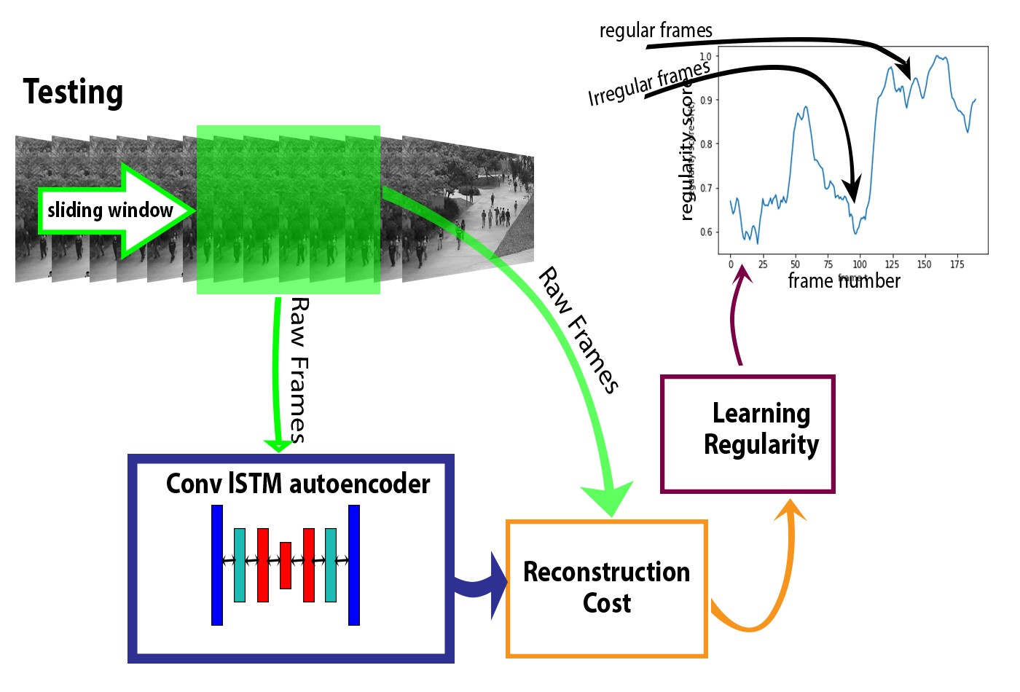

Slide 32
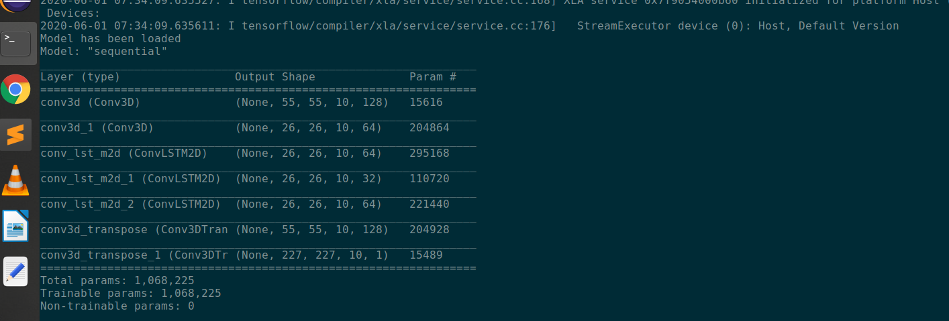
RESULTS
Model Summary of Conv3D
Two layers of Convolution , Three layers of temporal encoding and decoding and Two layers of Deconvolution

Slide 33
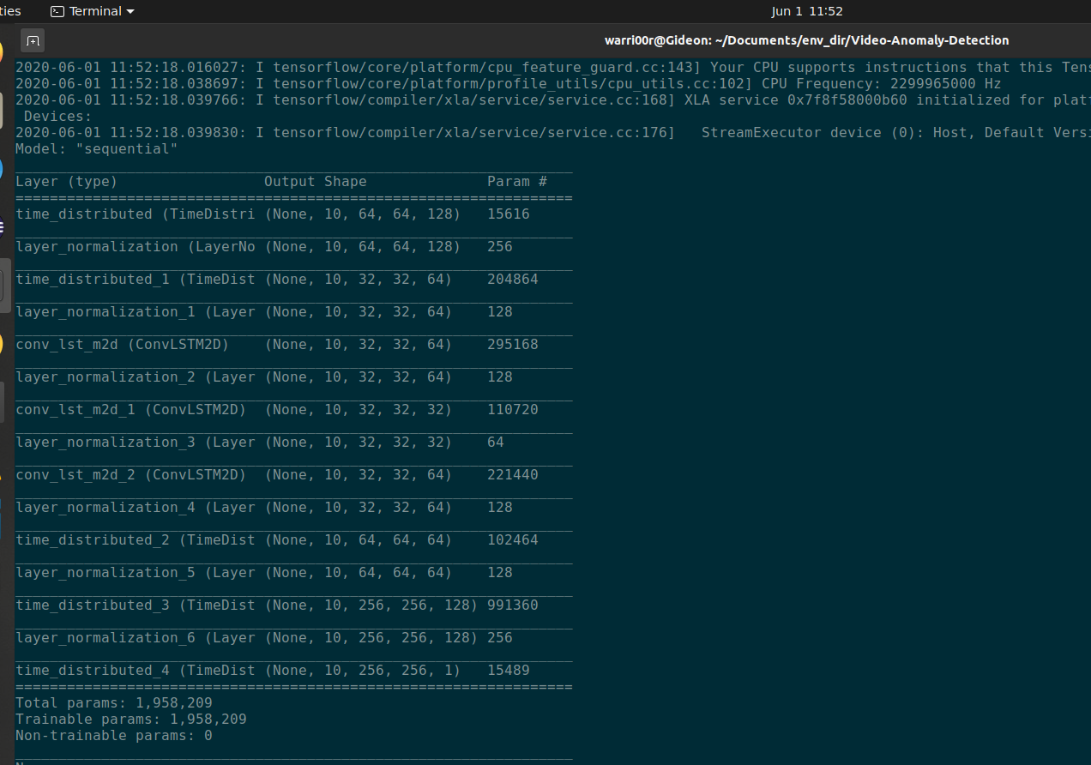
Model Summary of Time Distributed Conv3D
Layer Normalization between each temporal encoding and decoding layers

Slide 34
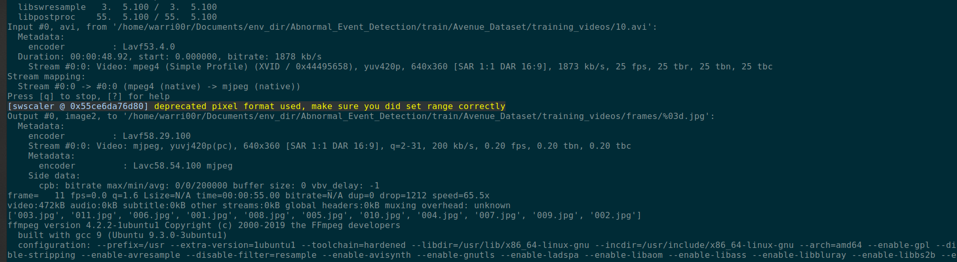
Preprocessing and feature extraction

Slide 35
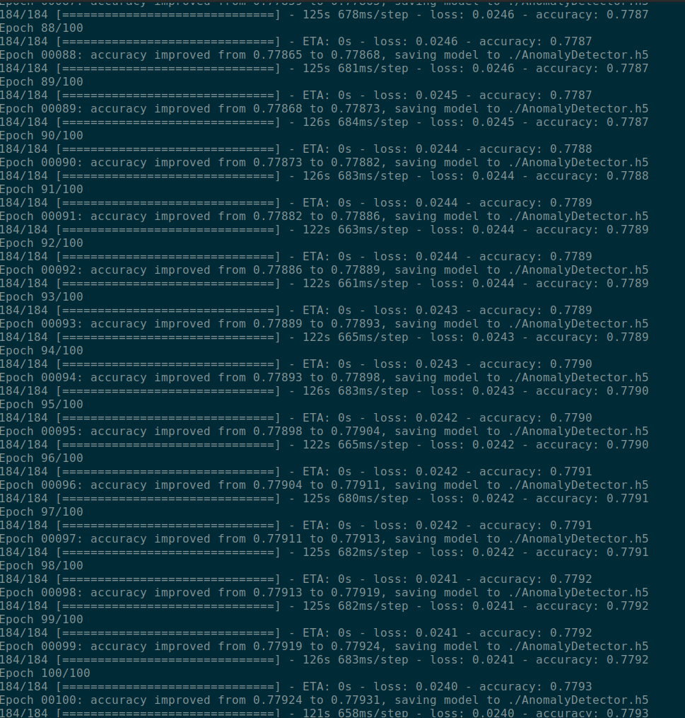
Training and Model Accuracy
Model is trained with 16 training videos with 100 epochs and the accuracy is upto 78%

Slide 36
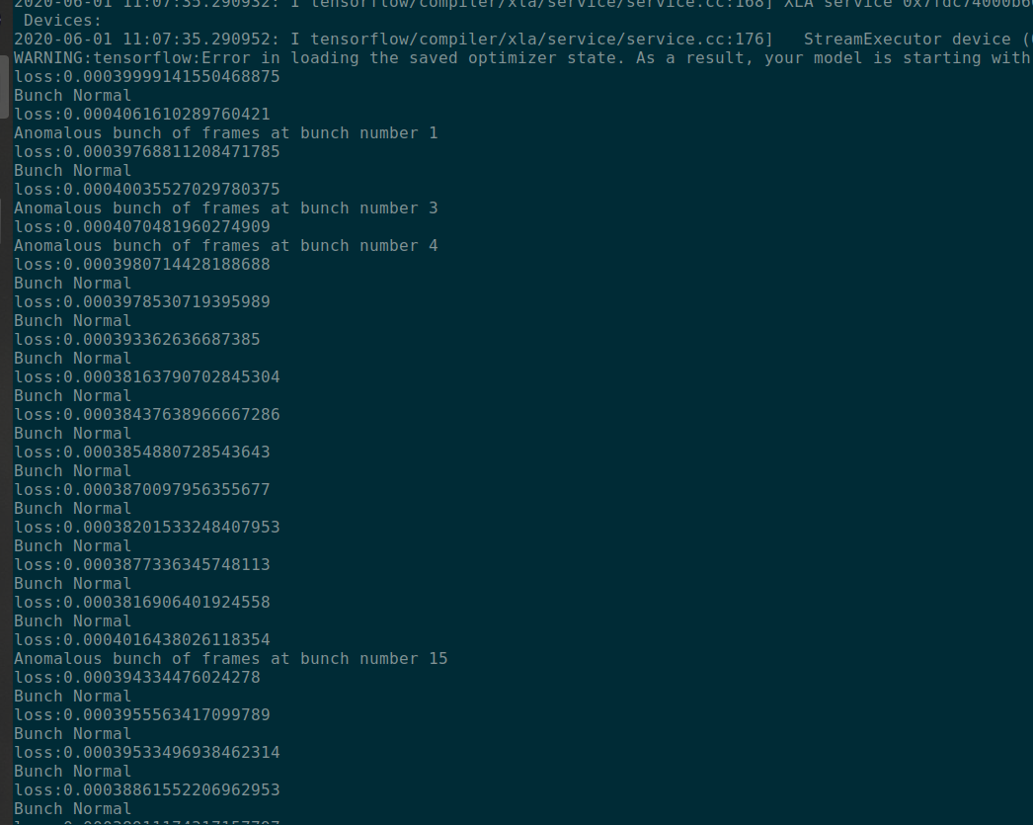
Testing
Model is tested with videos containing anomalies and are detected.

Slide 37
FUTURE SCOPES
In future, an additional task can be applied to model to get the human feedback and update its learning for better prediction and reduced false alarm rates
User Interface can be added which allows the user to watch the anomaly video at any time and any number of times
Immediate alarms can be generated when anomalies are detected thus making human more alert.

Slide 38
CONCLUSION
An efficient method is used to detect the anomalies in the videos consisting of crowded scenes
We proposed convolutional spatiotemporal architecture for abnormality detection.
This includes data preprocessing ,feature learning and building of trained model to test the abnormal events in videos.
It is all about the reconstruction error We use an autoencoder to learn regularity in video sequences.
The intuition is that the trained autoencoder will reconstruct regular video sequences with low error but will not accurately reconstruct motions in irregular video sequences.
And anomalies if present in videos can be detected.

Slide 39
REFERENCES
Oluwatoyin P. Popoola ,Kejun Wang “Video-Based Abnormal Human Behavior Recognition”—A Review Article in IEEE Transactions on Systems Man and Cybernetics Part C (Applications and Reviews) · November 2012
Chong, Yong Shean & Tay, Yong Haur. (2017). Abnormal Event Detection in Videos Using Spatiotemporal Autoencoder. 189-196. 10.1007/978-3-319-59081-3_23.
Waqas Sultani1 , Chen Chen2 , Mubarak Shah2 1Department of Computer Science, “Real-world Anomaly Detection in Surveillance Videos”, University of Central Florida (UCF) arXiv:1801.04264v3 [cs.CV] 14 Feb 2019

Slide 40
“Abnormal event detection in crowded scenes based on deep learning” Zhijun Fang & Fengchang Fei & Yuming Fang & Changhoon Lee & Naixue Xiong & Lei Shu & Sheng Chen(2018). DOI 10.1007/s11042-016-3316-3
Raksha S, B G Prasad “Anomalous Human Activity Recognition in Surveillance Videos”International Journal of Recent Technology and Engineering (IJRTE) ISSN: 2277-3878, Volume-8, Issue-2S7, July 2019

